Slide 1
Design Project Group 12
Alexander Blanchette, Maurice Channelle, Jamel Douglas, Michael Thomson, Christian Galarza, Andrew Vargas

Slide 2
About ACME’s Needs
Business Data Capabilities
Robust call center
Robust customer service center and online help portal
Includes mild automation such as phone trees and help wiki’s to help cut down on call center stress
Support for employees writing up comprehensive guides
Notes:
Alex

Slide 3
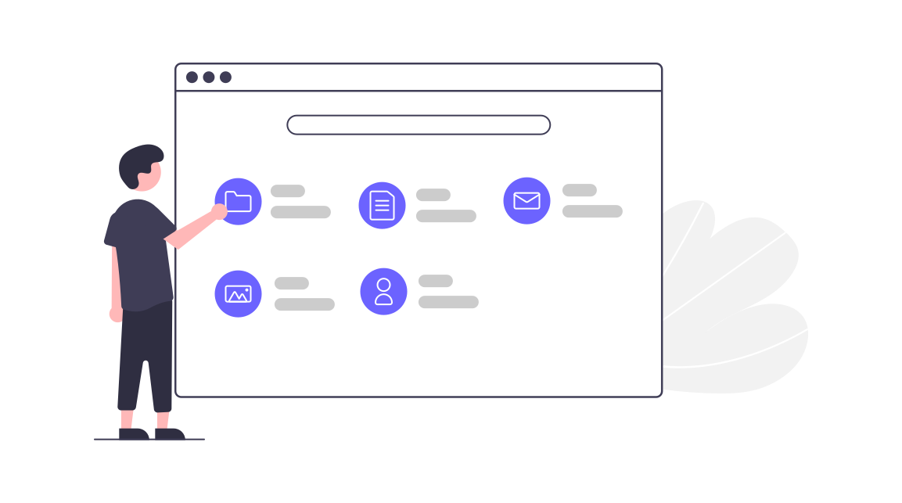
Required Network Services
Windows Server 2019
Active Directory (role)
DNS Server (role)
DHCP Server (role)
Print Server (role)
Web Server (role)
Email
Cloud hosted by Microsoft (Office365)
Database
Data Store. (Customer Info, Transaction Data)
PBX Server
VOIP Phone System
Ticketing System
Issue Tracking System
Windows Subsystem for Linux
Used to run any services that don't run natively in Windows

Slide 4
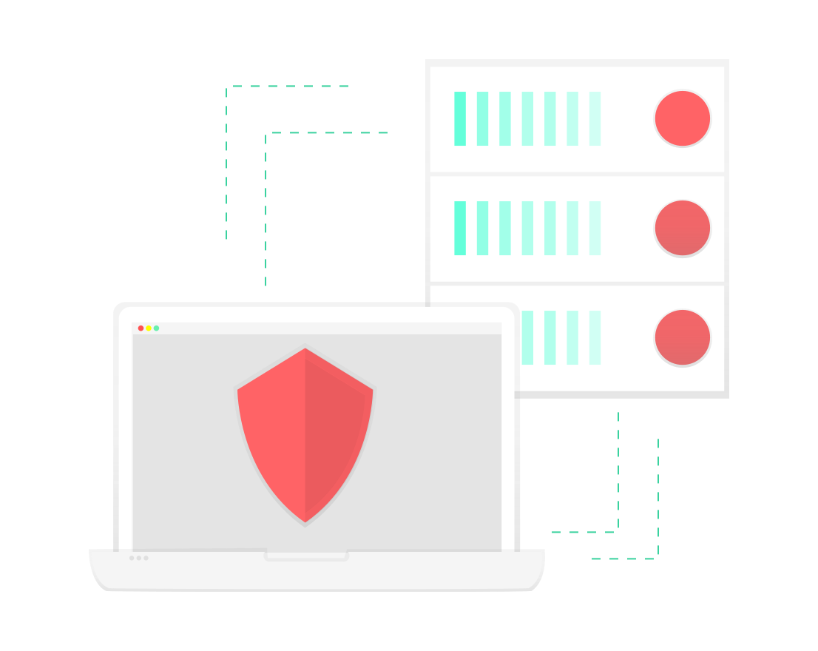
Required hardware
Firewall and Router-Cisco Firewall Cisco Firepower 2100 Series
Switches- Cisco Catalyst series 9200
WAP- Cisco Catalyst 9105 AX series access points controlled using the Cisco Catalyst 9800-L controller
Workstation- Dell Inspiron Desktop
VoIP Phones- Cisco IP Phone 7861 Series
Headsets- Cisco Headset Wireless 500 Series
Windows Server Hardware- PowerEdge R540 Rack Server

Slide 5

Required Software
Virus protection
Norton
Microsoft Enterprise Package
Office 365
Windows Server 2019
MS SQL Server 2019
Pbx(phone) software
Fusion PBX
Ticketing System
Zendesk
Data protection
BitLocker
Brain Tree & Paypal for payment processing
Notes:
Alex

Slide 6

To-Buy List
Hardware:
Cisco Router- $1,105
Switches - Cisco Catalyst 9200 Series- $4,235
WAP wireless access point - Cisco Catalyst 9105AX series Access points controlled by the Cisco Catalyst 9800-L Wireless Controller- $1,364
Workstations- Dell Inspiron Desktops 1099.00
Software:
Norton - $99.99/year
Microsoft Enterprise package - $20.00/Month
Pbx software- $1000/per employee
Zendesk - $199/Year
Bitlocker Professional - $100

Slide 7
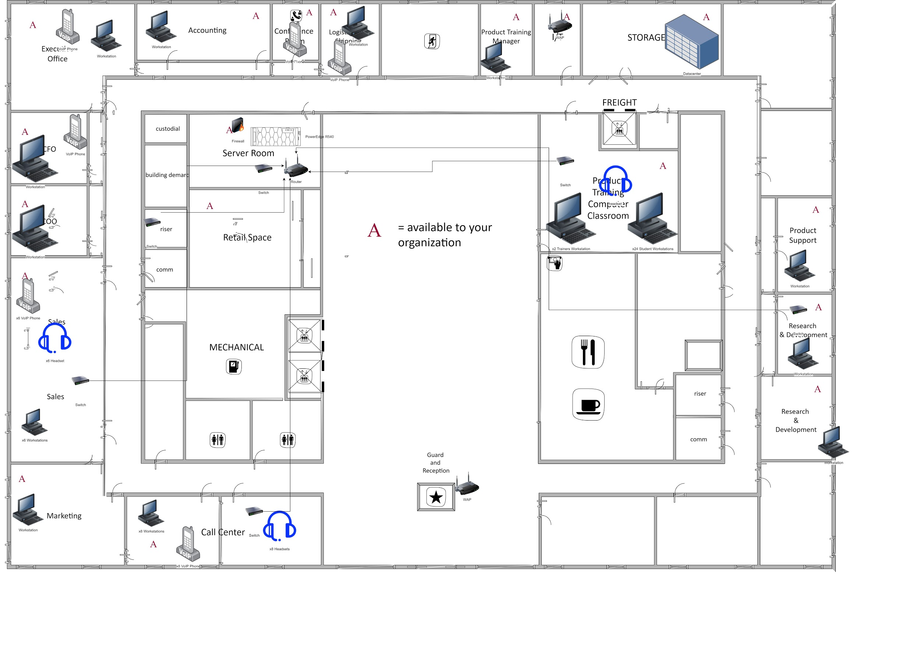
Model # 1

Slide 8
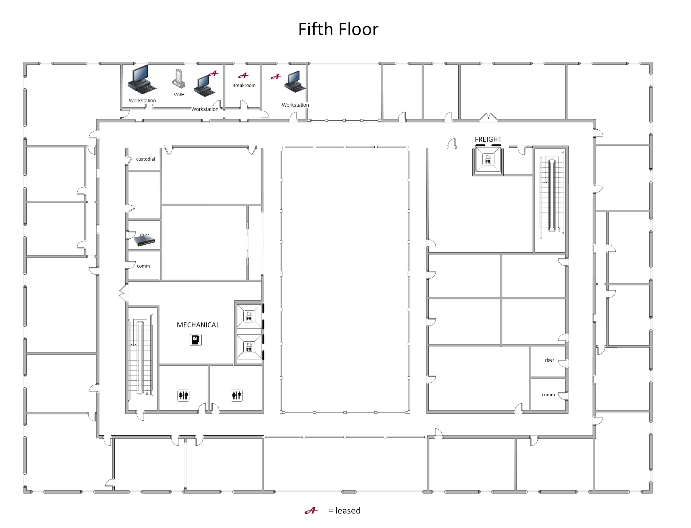
Model # 2

